Slide 1
Image Compression Benchmarking
Mischenko V., Rassadin A., Rusov N.
National Research Institute “Higher School of Economics”
2016

Slide 2
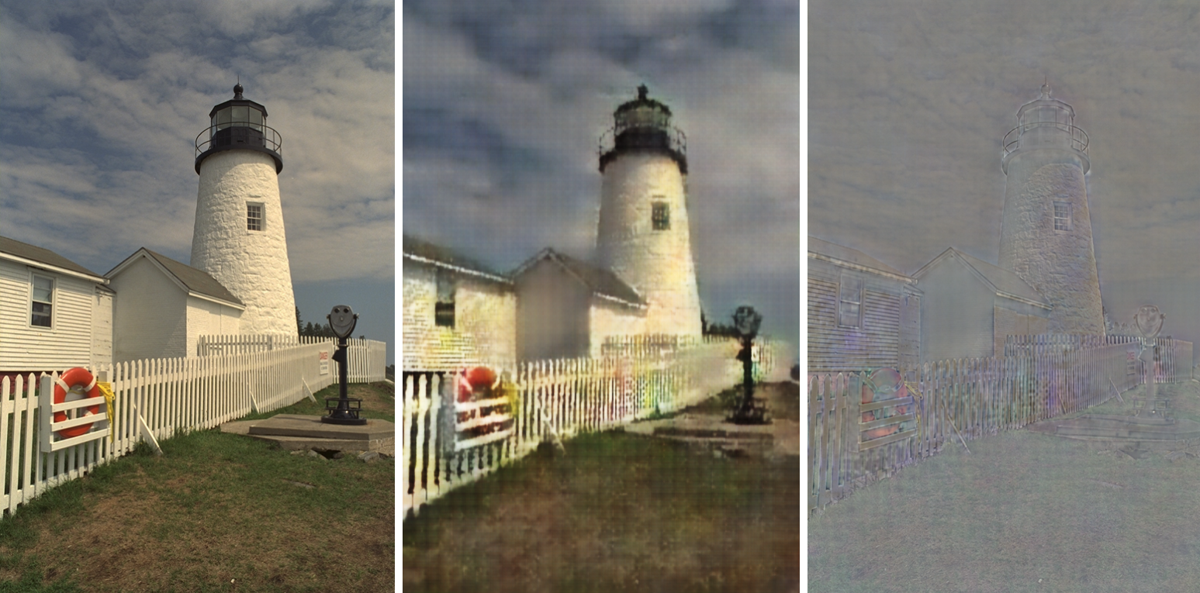
«Full Resolution Image Compression with Recurrent Neural Networks»
George Toderici, Damien Vincent, Nick Johnston, Sung Jin Hwang, David Minnen, Joel Shor, Michele Covell Google Inc.
The paper presents an approach of lossy image compression based on neural networks. Authors provides an neural network model that allows variable compression rates during deployment without network retraining so that the network needs to be trained only once. Proposed model consist of a recurrent neural network (RNN)-based encoder and decoder, a binarizer, and a neural network for entropy coding. We compare RNN types and introduce a new hybrid of GRU and ResNet.

Slide 3
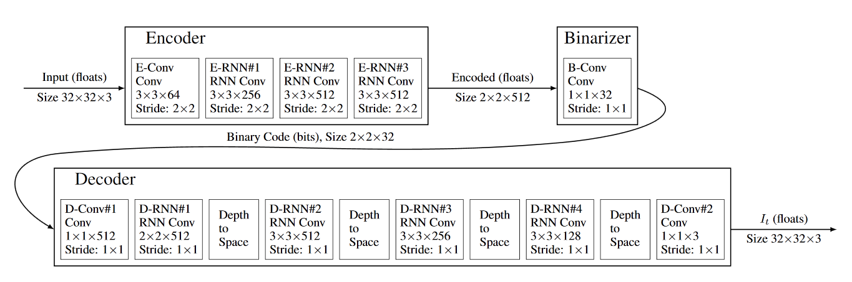
«Full Resolution Image Compression with Recurrent Neural Networks»
Algorithm
The initial residual, R[0], corresponds to the original image I: R[0] = I
Set i = 1 for to the first iteration
Iteration[i] takes R[i-1] as input and runs the encoder and binarizer to compress the image into B[i]
Iteration[i] runs the decoder on B[i] to generate a reconstructed image P[i]
The residual for Iteration[i] is calculated: R[i] = I - P[i]
Set i = i + 1 and go to Step 3 (up to the desired number of iterations)

Slide 4
Project Strategy
Perform benchmarking of Toderici et al. compression Method by comparison of compression results via popular compression algorithms (jpeg, jpeg2000, png, webp)
Quantitatively and qualitatively evaluate results of compression Method also by processing time and compression size
Answer the question of applicability of the Method in real life

Slide 5
Recurrent Neural Networks
A Recurrent Neural Network is a class of artificial neural network where connections between units have form of directed cycle. This creates an internal state of the network which allows it to exhibit dynamic temporal behavior. Unlike feedforward neural networks, RNNs can use their internal memory to process arbitrary sequences of inputs.

Slide 6
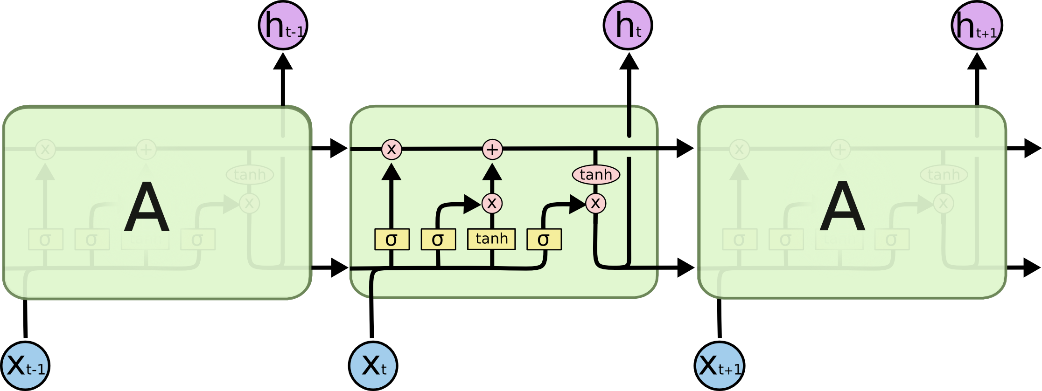
Long Short-Term Memory
Long Short-Term Memory is a kind of RNN building block proposed in 1997.
A LSTM block may be described as a "smart" unit that can remember a value for an arbitrary length of time. A LSTM block contains gates that determine when the input is significant enough to remember, when it should continue to remember or forget the value, and when it should output the value.

Slide 7
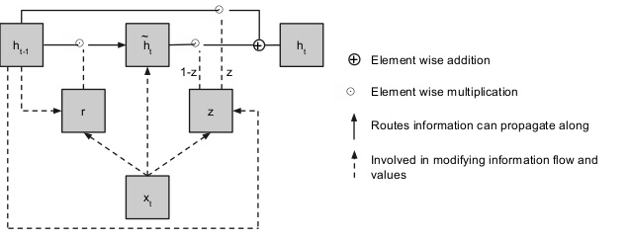
Gated recurrent unit
Gated Recurrent Unit is a kind of RNN building block introduced in 2014.
Their performance on polyphonic music modeling and speech signal modeling was found to be similar to that of LSTM unit but it have fewer parameters than LSTM, as they lack an output gate.
Residual GRU combines existing GRUs with the residual connections to achieve significant image quality gains for a given compression rate.

Slide 8
Benchmarking

Slide 9
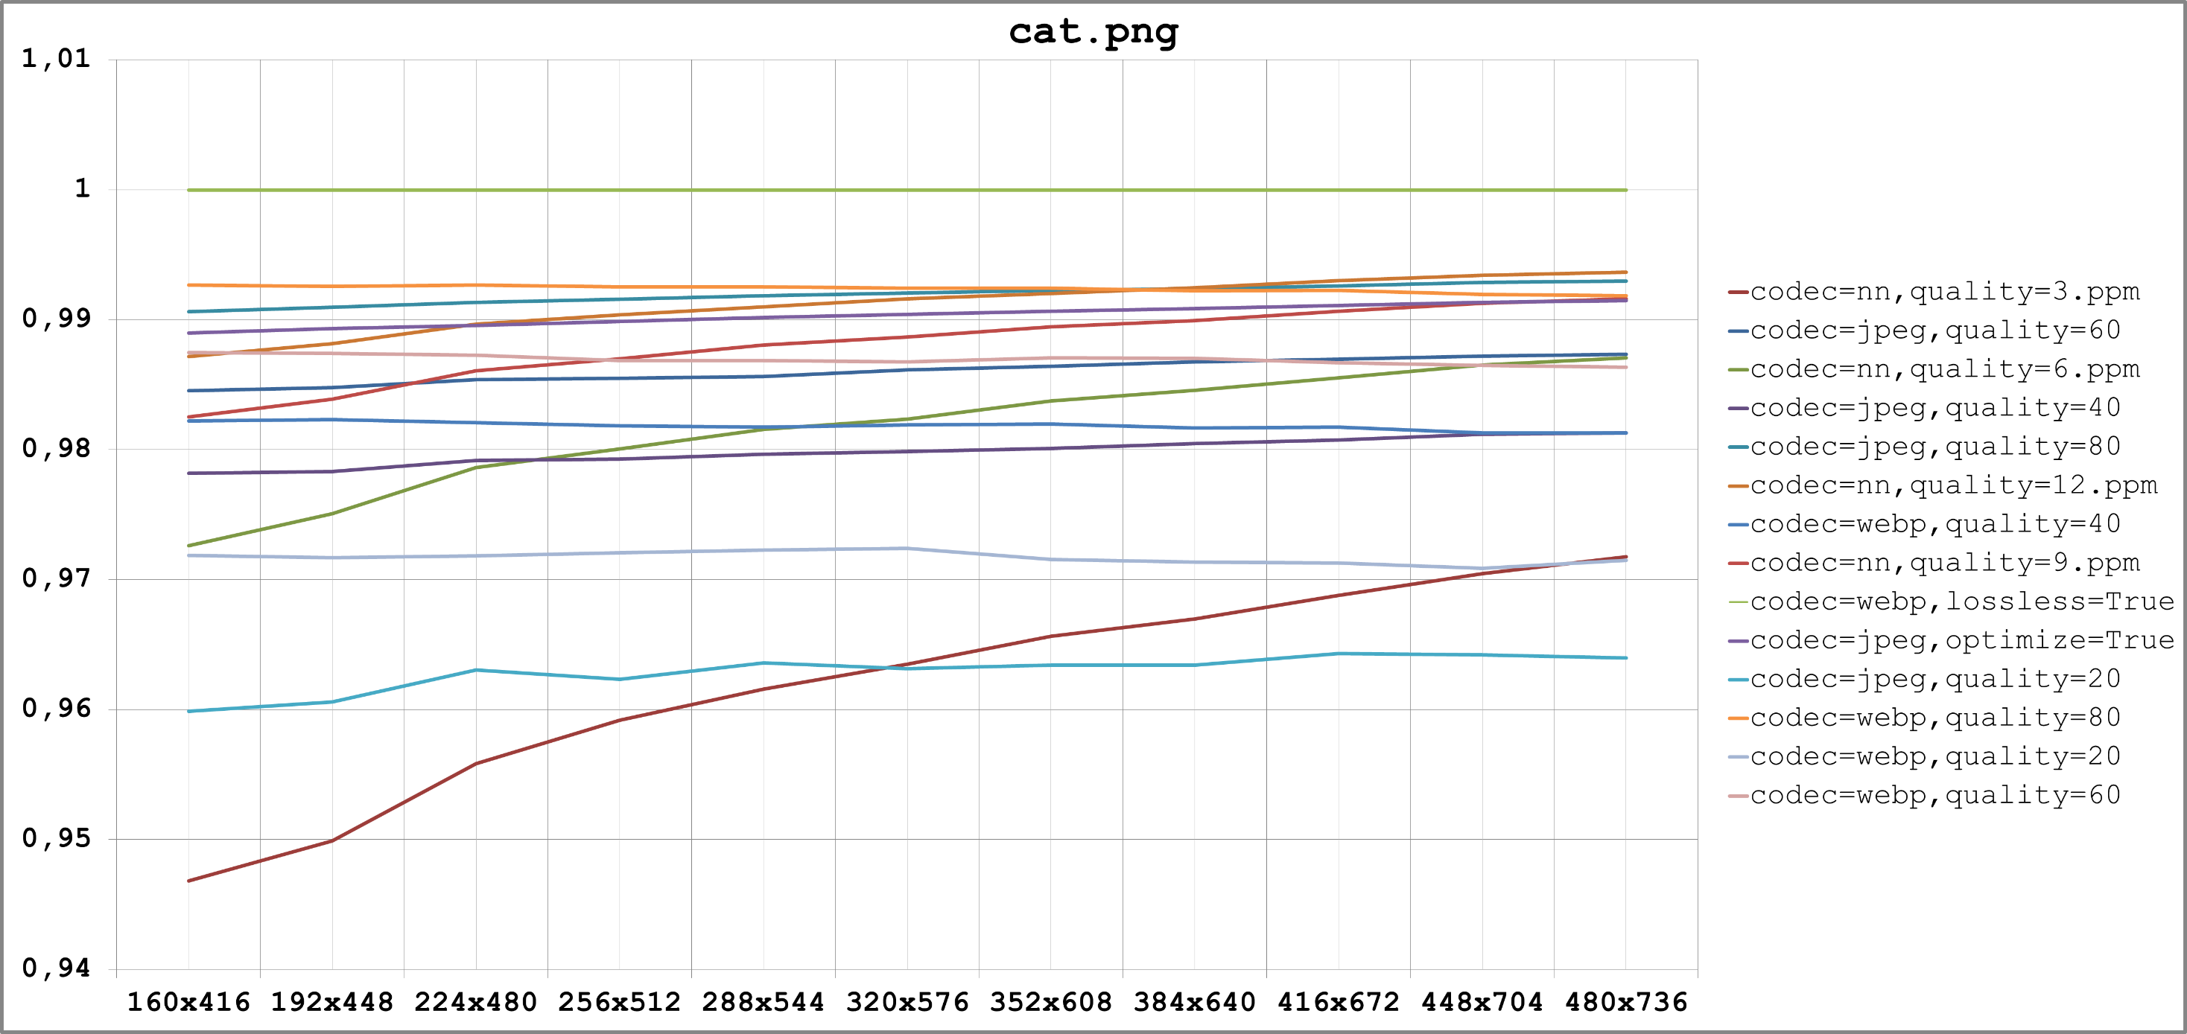
Benchmarking Results

Slide 10
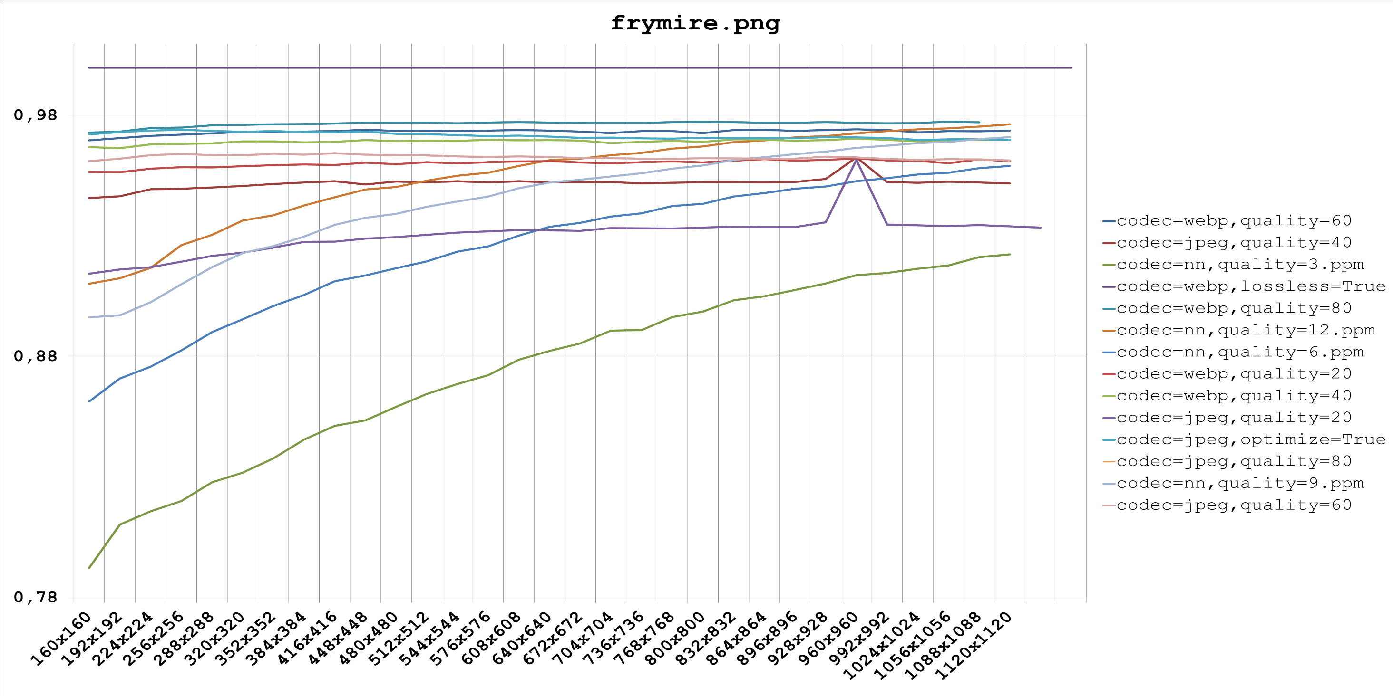
Benchmarking Results

Slide 11
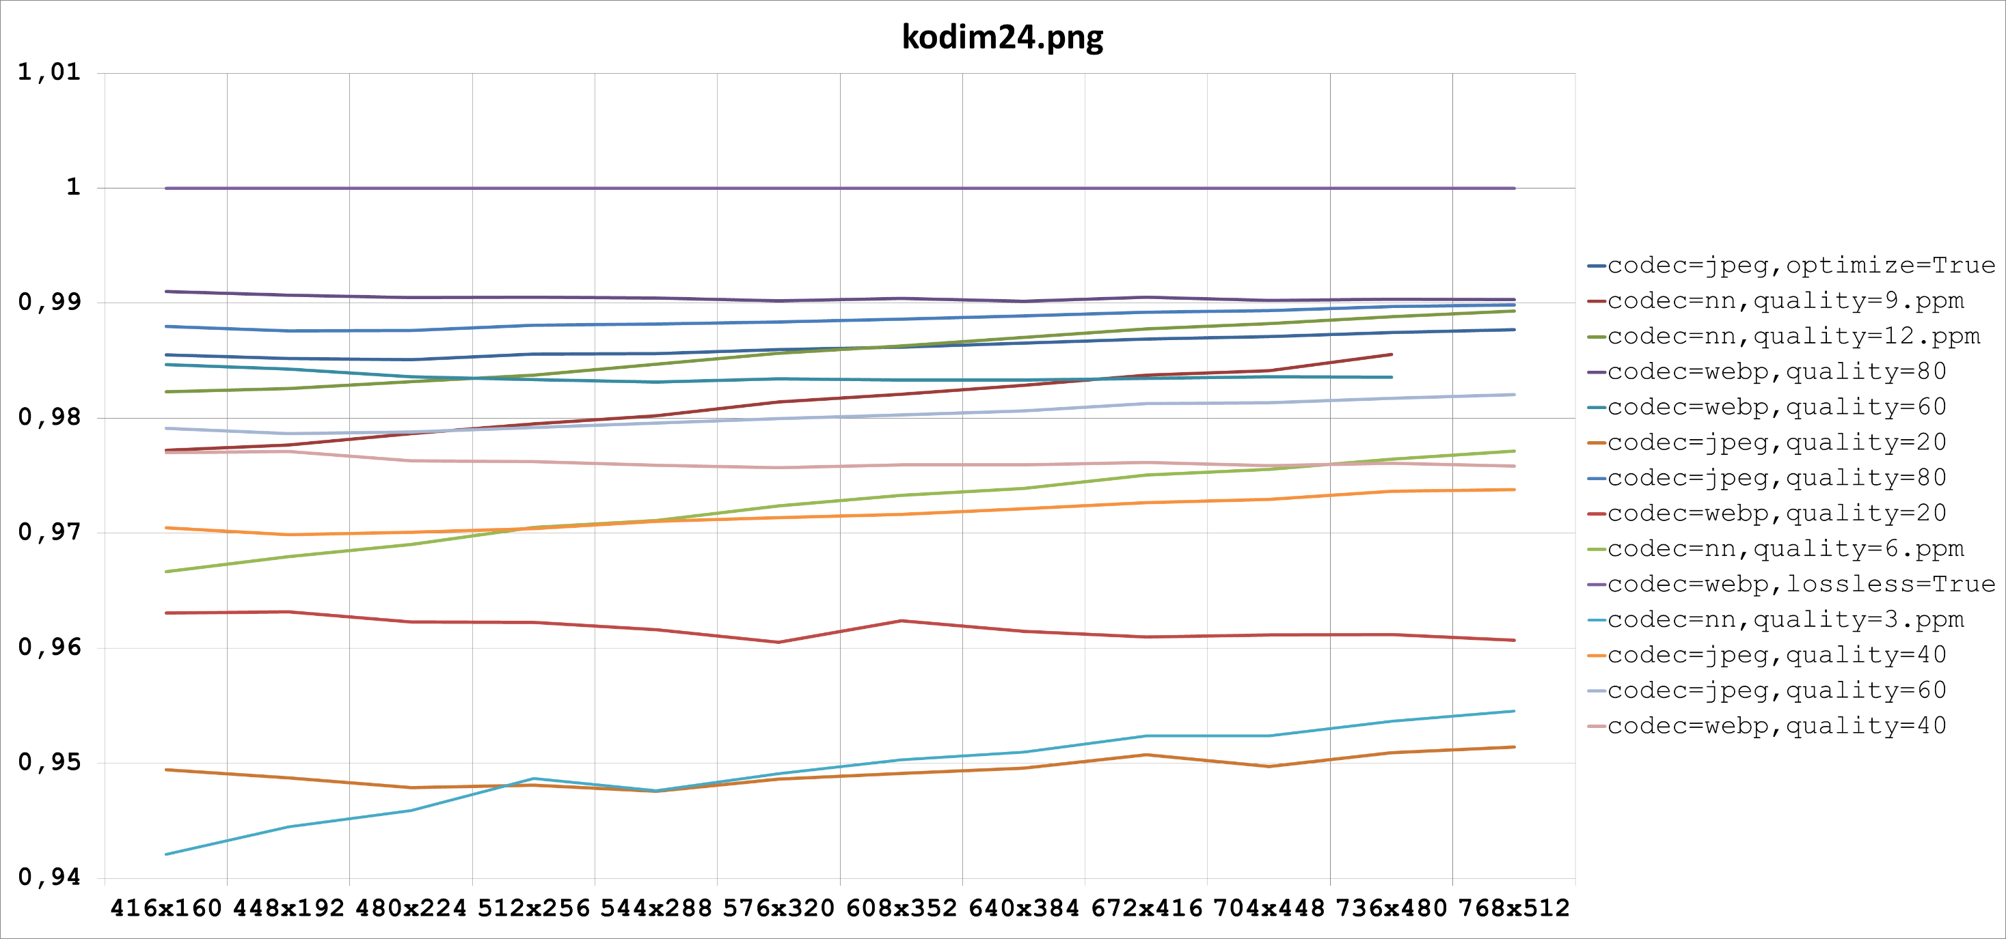
Benchmarking Results

Slide 12
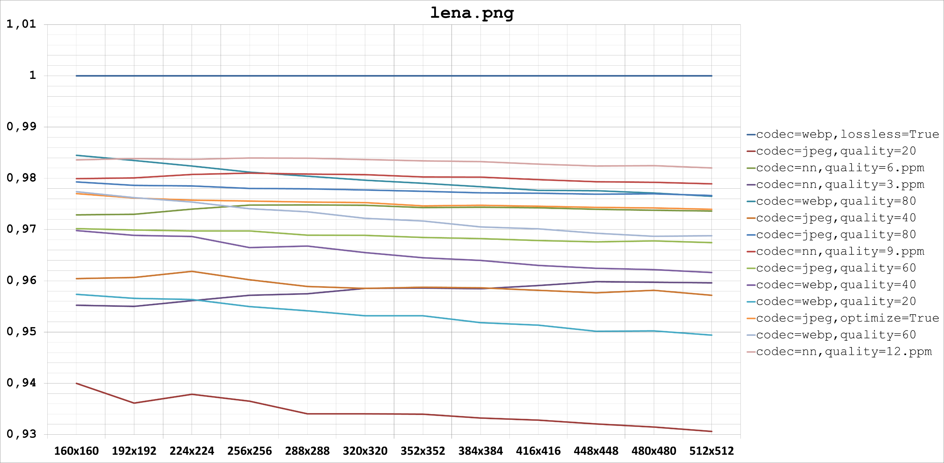
Benchmarking Results

